Slide 1
eLearning Internationalization
Hossein Akhlaghpour
ObjectJ Inc.
hossein@objectj.com

Slide 2
Outline
Market Analysis of eLearning
Internationalization of eLearning
e-Health Portals
Fermat Learning Group
Future Trend of eLearning
Conclusion

Slide 3







History of eLearning
Since 1998
eLearning in Industry & Academy

Slide 4
eLearning Components
Mentoring
eLearning
Tools
eCourse
Development

Slide 5
eLearning Tools
Authoring
Tool/ LCMS
ICT Systems
LCMS
Assessment
Tool
Develop Courses
Present Courses to Students
Track Students Usage
Get Student Feedback
Connect Student & Instructors
Makes eLearning systems to work together
Connect eLearning to Other Systems
Virtual
Classroom

Slide 6




Learning Content
Management System
Content
Progress
Report
Author
Content
Progress
Report
Live
Instructor
Student

Slide 7
LCMS
Admit students (Admission)
Assign students to departments
Assign courses to departments
Determine the course hierarchy: prerequisite between courses
Register courses for students or allow them to register courses considering their hierarchy
Track student's usage (whether student has viewed lessons).

Slide 8
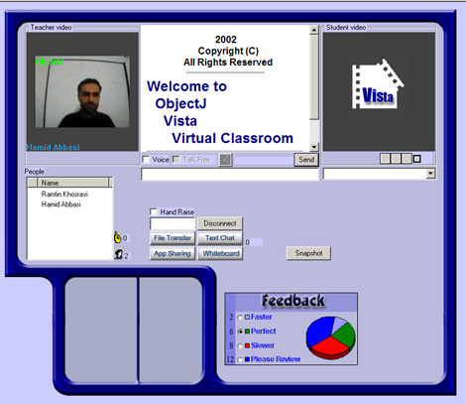


eLearning Virtual Classroom
Student
Video
Instructor
Video
Professional
Services
Students
List
Class
Feedback

Slide 9



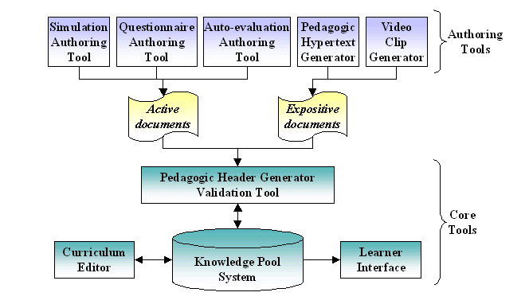




eLearning Standards
IMS Content Packaging (IMS CP)
IMS Digital Repositories Specification
IMS Enterprise Specification
IMS Learner Information Package (IMS LIP)
IMS Learning Design Specification
IMS Question & Test Interoperability (IMS QTI)
IMS Reusable Definition of Competency or Educational Objective (IMS RDCEO)
IMS Simple Sequencing Specification
IEEE Learning Object Metadata (LOM)

Slide 10
Market Estimation
Only in Iran:
1.5 million candidates / year
About 1 million candidate cannot enter any Universities
Average fee of $2000 / student / year
$2 billion market
Add China, India, Arab countries =>
The market is unlimited
(not even including African countries & poor countries like Afghanistan)

Slide 11



eLearning in Iran
3000 students in University of Tehran took 5 courses in a blended eLearning format
University of Elmosanat is taking more than 2000 eLearning students this year with about 50 TAs.
More than 100,000 hours of eLearning courses is seen by student in the last 6 months
We predict the number of students increases to 10,000 by end of 2006

Slide 12
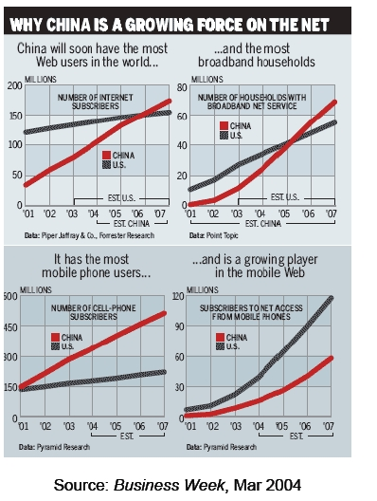
China & Internet
China’s educational system—according to
it’s Ministry of Education— has:
● 1,984 higher education institutes
● 3.35 million higher education students with
an additional 270,000 enrolled for postgraduate
study
● 400,000 Chinese nationals studying overseas
● China’s use of electronic media has
exploded. In 1997, 620,000 people in China
had Internet accounts and in 2002 that
figure stood at 59.1 million. This puts China
second in the world for Net connectivity.
China may pass the United States in the
number of Internet users within two years;
it already leads the world in cell phone
users.

Slide 13
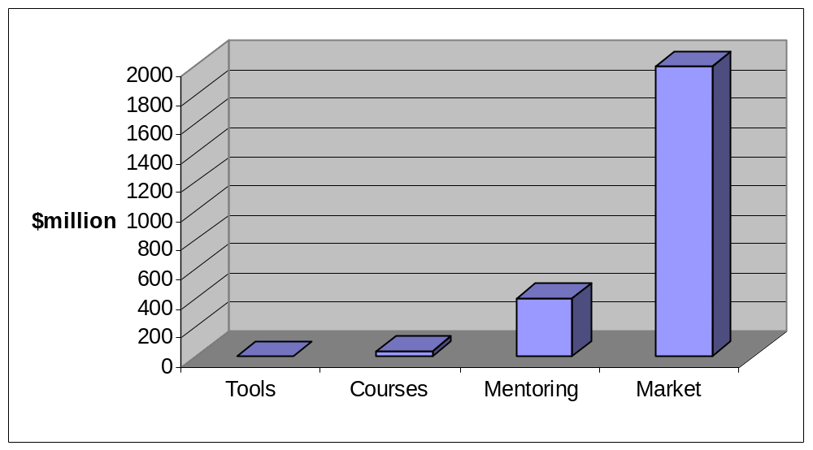
Cost-Benefit Analysis
A typical top US university annual budget ~ $2 billion
Market justifies investment
Save mentoring
at the cost of
high quality courses &
having the best tools
Save course development
at the cost of
having the best tool

Slide 14
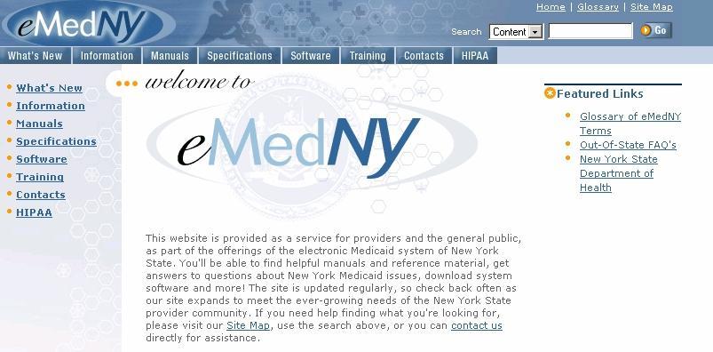
Electronic Medicaid System of NY State

Slide 15
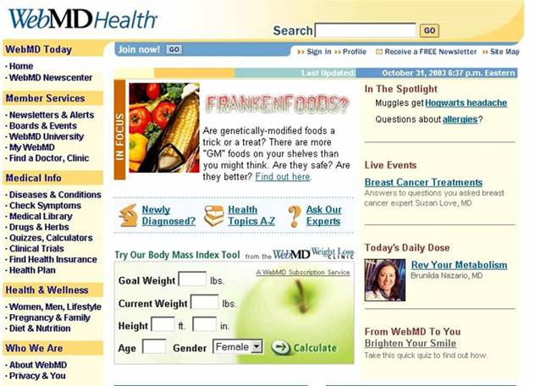
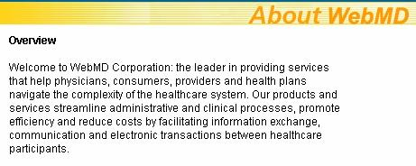
WebMD Health Care Portal Service

Slide 16
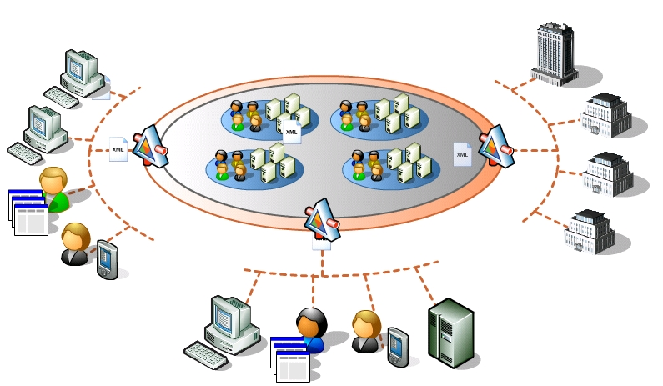
Utopia!
Department of Health
External
Systems
Hospitals
Other Businesses
Insurance Companies
Portals
Pharmacies
Physicians

Slide 17

Iterative Solution
Policy/Procedure
Technology
Legislation

Slide 18
Fermat Learning Group Objectives
Provide high quality blended eLearning solutions to countries with a demand for higher education and will serve to streamline existing eLearning opportunities provided by top universities across the world.

Slide 19

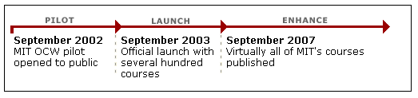
Open Courseware Project
Aeronautics & Astronautics
Anthropology NEW
Biology
Chemical Engineering
Chemistry
Civil & Environmental_x000b_Engineering
Comparative Media Studies NEW
Earth, Atmospheric, &_x000b_Planetary Sciences
Economics
Electrical Engineering &_x000b_Computer Science
Engineering Systems Division b
History NEW
Linguistics & Philosophy
Literature NEW
Materials Science &
Engineering NEW
Mathematics
Mechanical Engineering
Nuclear Engineering NEW
Ocean Engineering
Physics
Political Science
Sloan School of Management
Urban Studies & Planning

Slide 20


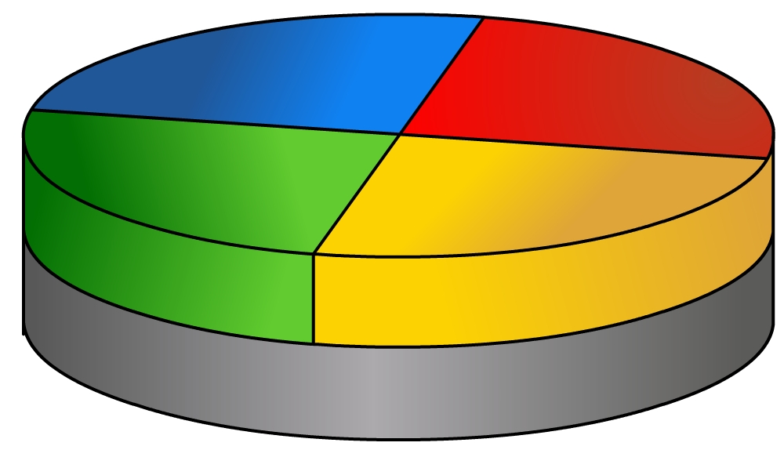
Future Course Development
Part-X
courseware
Part-Y
Syllabus is changing!
Part-Z
Part-W
Extended CourseWare
Extended CourseWare
Open CourseWare

Slide 21
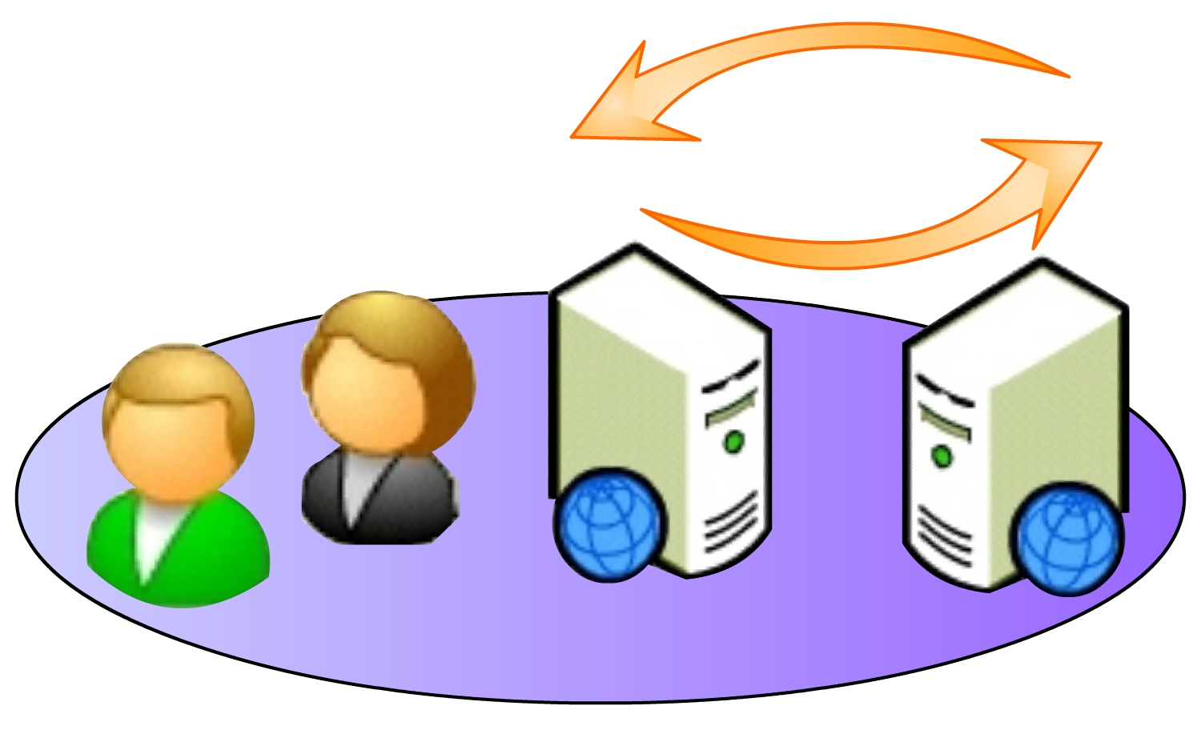
University Collaboration Framework
Learning Group
Learning Group
Open CourseWare

Slide 22






Multi-Source course development using SCORM
University
University
University
University

Slide 23







Delivering high quality courses
Application Server
internet
Local Server

Slide 24


Future Course Distribution
internet
Application Server
Coffee-net

Slide 25



Multi-layer Mentoring System
instructor
TA
TA
Student

Slide 26
Dynamic Nature of eLearning
You can mix & match different courses and create new course
You can mix & match courses from different dept and create new majors
You can mix & match eLearning with conventional learning and create more efficient blended eLearning

Slide 27
Conclusion
Internationalization of eLearning is unavoidable
Open courseware program is a base for future eLearning infrastructure
Learning groups is the base for exchanging programs and offering courses to multinational students (via host universities)
The best eLearning university will be recognized by the quality of their mentoring systems & students
Eventually there won’t be any line between eLearning and conventional learning such that they merge together

